Slide 1
Berlin Stores Analysis
Gloria Amakude
Tableau

Slide 2









Brief Summary:
This project analyzes customers visit to 6 stores in berlin which includes;
3 Grocery stores (Kaufland, Aldi, Rewe),
3 fast food stores (McDonalds, Burger King, subway),
3 automobile stores (Lexus, Mercedes, Renault),
using GPS signals of users, and outline of the stores (referred to as polygons) to derive useful insights to the data.
The datasets contains randomly selected data for the period of January 1st 2021 to January 21st 2021.

Slide 3
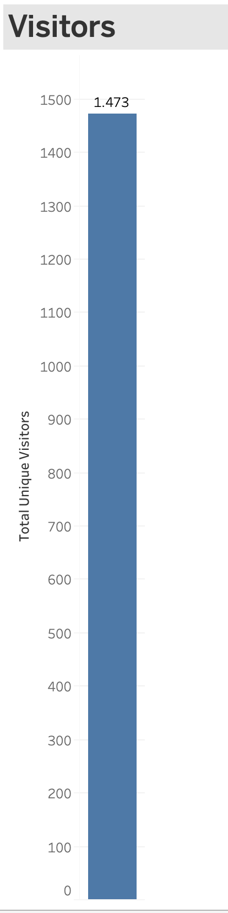
A total of 1473 uniques visitors were recorded during this analysis.

Slide 4
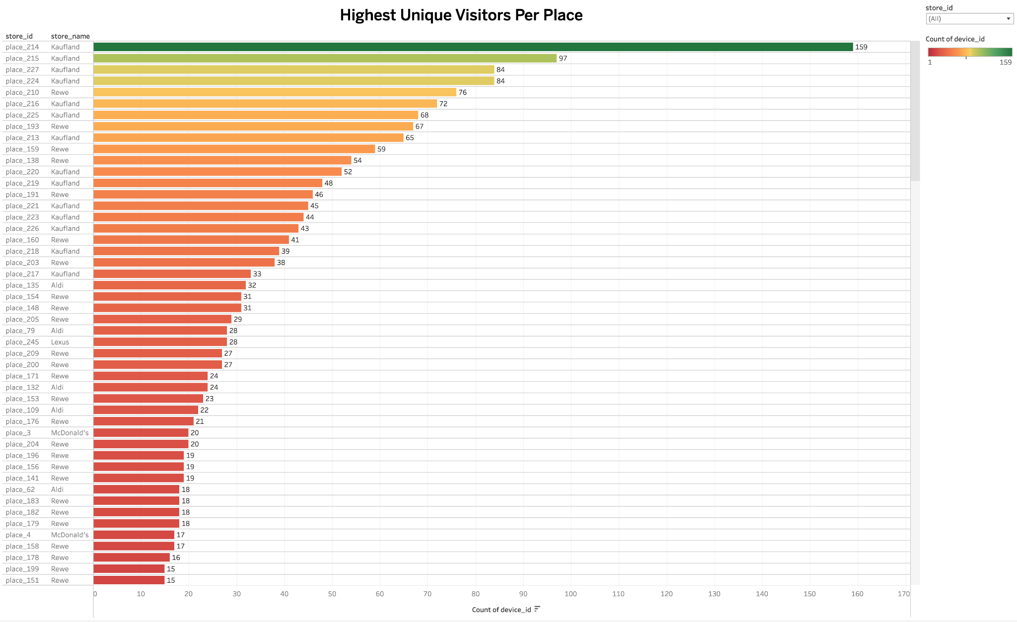
Kaufland’s Store (place 214), recorded the highest overall visit with a total of 92 visitors.

Slide 5
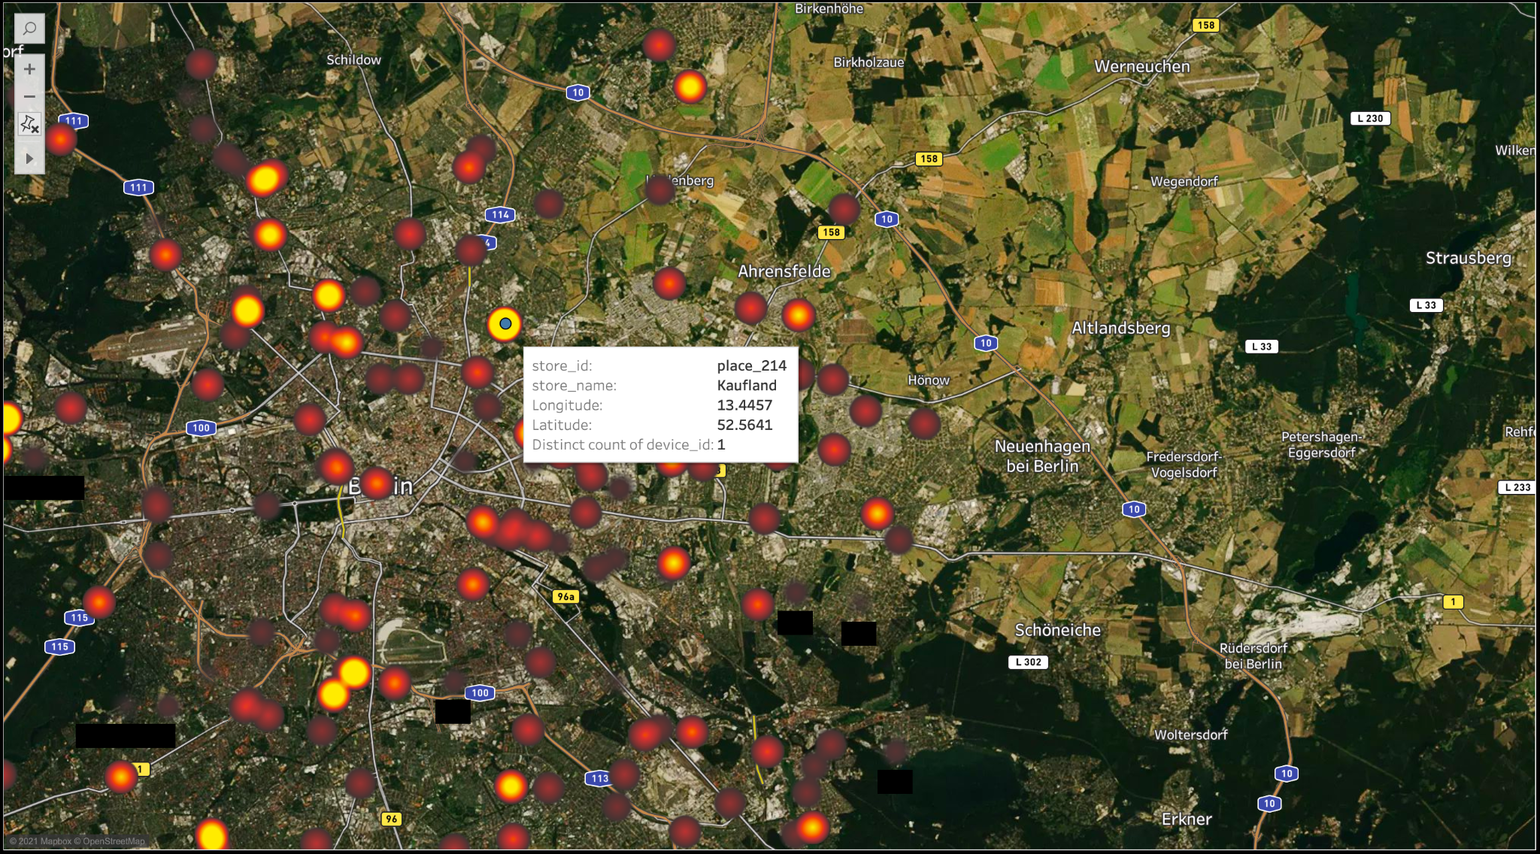
A heat map visualizing the GPS Signals of visitors in Berlin

Slide 6
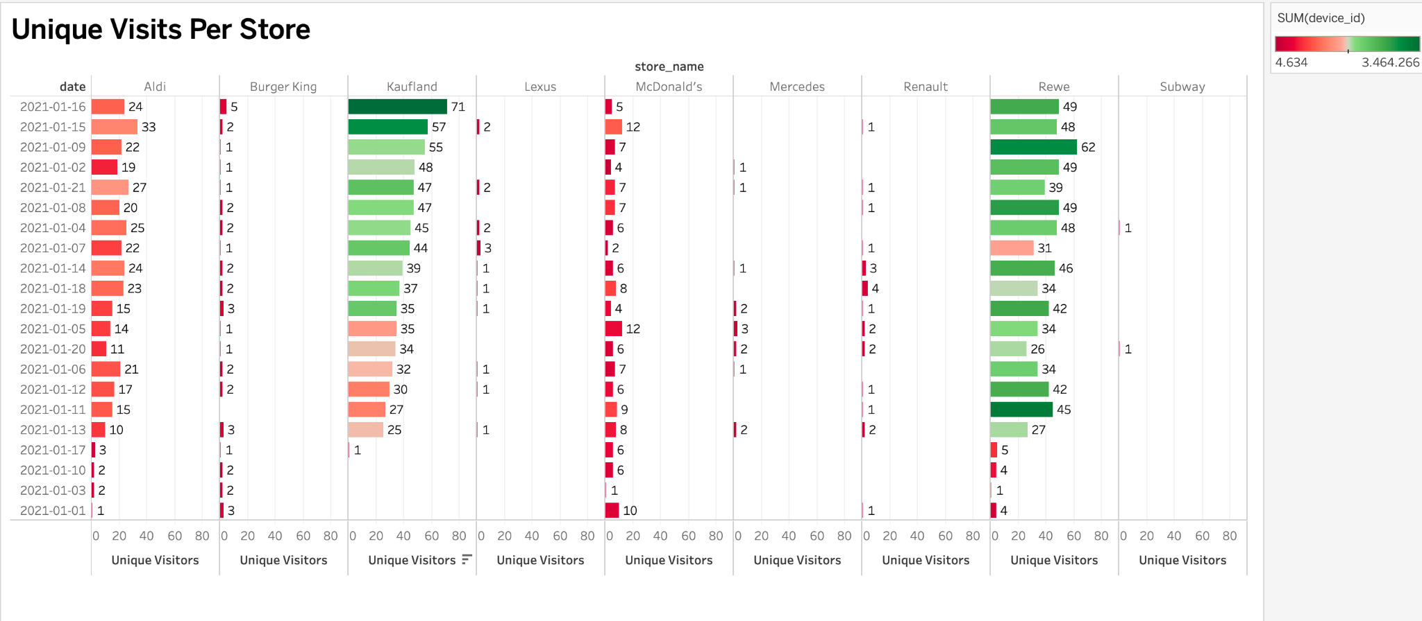
Visualization of the Daily summary of store visits across all sample stores

Slide 7
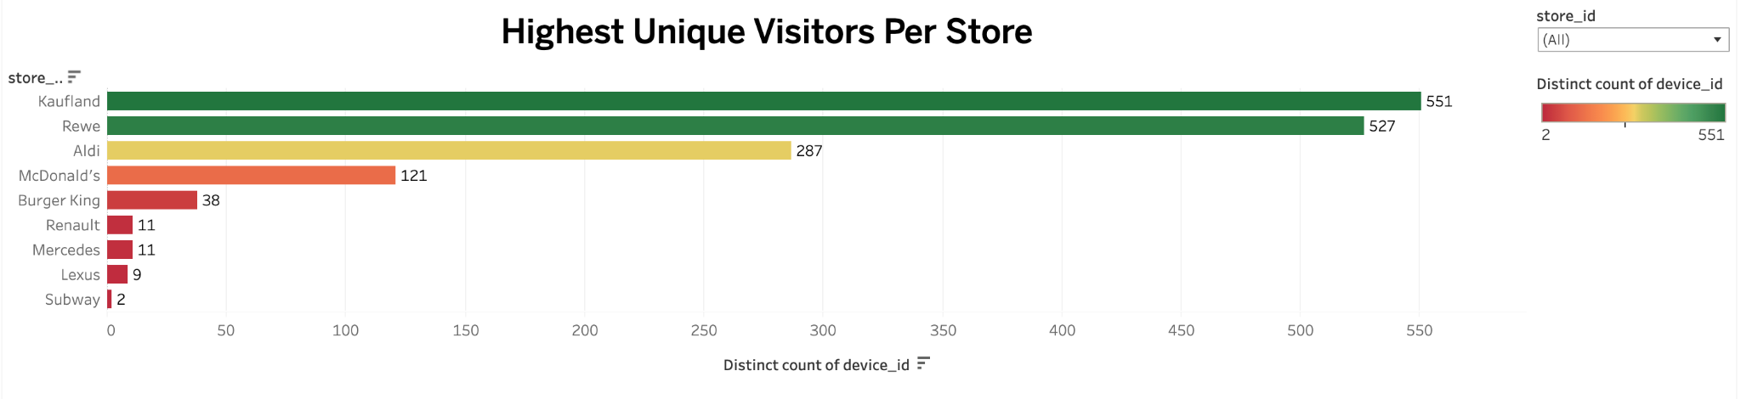

Slide 8
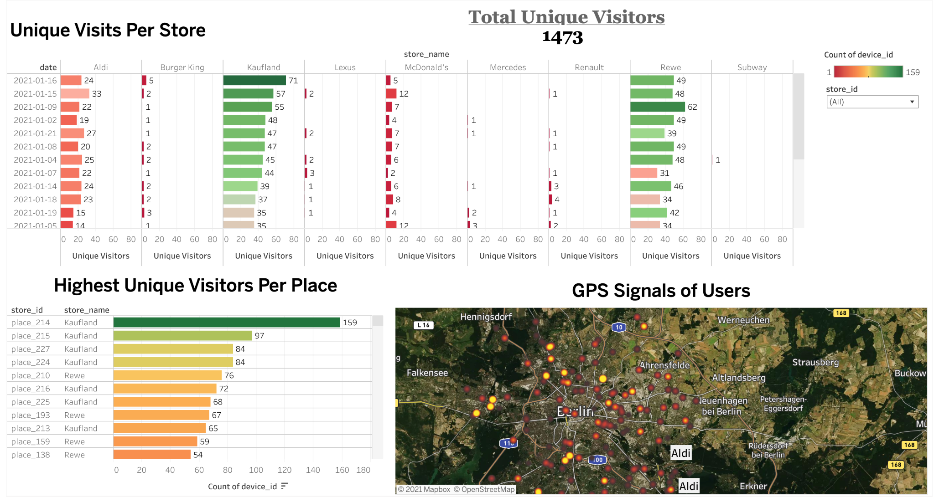

Slide 9
Conclusion:
The analysis show that the stores had more visitors within the middle of the month of january (2021-01-16 and 2021-01-15) with a total of 1473 visits for all six (6) stores. While the lowest number of visitors was recorded on the 3rd and 1st of January.
Kaufland, which is a food retail company, offering a wide range of groceries and everything for daily needs, had the most visits with a total of 159 visitors at store 214 within the month. It also recorded the highest number of single day visits(23) on the 16th of January 2021. In total, the average number of unique visitors per day for all stores was about 130 visitors.
Kaufland and Rewe were the most visited grocery stores and had a total of 551 and 527 visits respectively during this period. This is expected because they are grocery stores and have a higher number of daily in store purchases.
McDonalds had the Highest overall and single day visitors(12) when it came to the fast food stores as compared to Burger king. While Subway had the least visitors during this period.
Finally the automobil stores showed lower number of daily visitors. This is expected because most customers are online shoppers and so users would mostly place a call to the sales team and schedule service appointments before visiting. On average, the stores sees less in store visits per month and more click-to-calls per month. There was no significant difference between the average daily visitors between the automobile stores.

